Slide 1
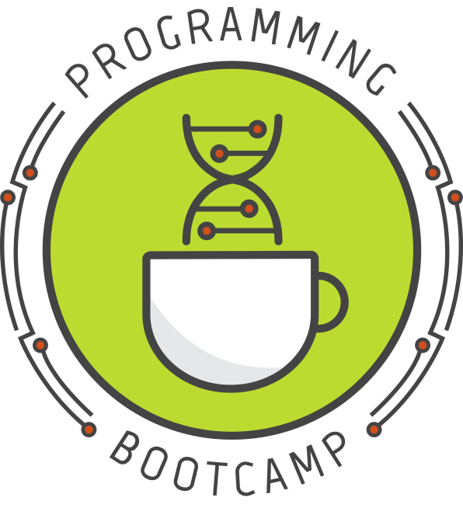


Writing code that makes decisions: for and while loops
Lesson 3 – 7/9/19
Slides by Sara Middleton
(Please sign-in)
Sponsored by:
Notes:
With notes!

Slide 2








Today’s TAs
Apexa
Sammy
Ben
Alex
Chris
Dr.
Shweta Ramdas
Louis
Kathy

Slide 3
Lab2: Review
“and” and “or” boolean operators allow building complex expressions

Slide 4
“and” and “or” operators
operation | condition1 | condition2 | result
and | True | True | True
and | True | False | False
and | False | True | False
and | False | False | False
or | True | True | True
or | True | False | True
or | False | True | True
or | False | False | False

Slide 5
“and” and “or” operators
smile = True
age = 27
if smile and age<=13:
print("smile back!")
else:
print("turn away")

Slide 6
“and” and “or” operators
smile = True
age = 27
if smile or age<=13:
print("smile back!")
else:
print("turn away")

Slide 7
Lab2: Review
“and” and “or” boolean operators allow building complex expressions
Remember, less is more in coding. Avoid making unnecessary objects.

Slide 8
Quadratic formula
import sys
a = float(input("Enter value for a: "))
b = float(input("Enter value for b: "))
c = float(input("Enter value for c: "))
underRoot = (b**2 - 4*a*c)
if underRoot < 0:
print("non-real answer")
else:
x1 = (-b + (b**2 - 4*a*c)**.5)/2*a
x2 = (-b - (b**2 - 4*a*c)**.5)/2*a
print ("x =", x1, "or", x2)

Slide 9
Quadratic formula
import sys
a = float(input("Enter value for a: "))
b = float(input("Enter value for b: "))
c = float(input("Enter value for c: "))
underRoot = (b**2 - 4*a*c)
if underRoot < 0:
print("non-real answer")
else:
x1 = (-b + underRoot**.5)/2*a
x2 = (-b - underRoot**.5)/2*a
print ("x =", x1, "or", x2)

Slide 10
How many times was tails flipped?
# heads is 1, tails is 0
# flip the coin 3 times
# print the number of heads
import random
heads = random.randint(0,1) + \
random.randint(0,1) + \
random.randint(0,1)
print (“heads:”,heads)
------------------------
PRINTS: “heads: 1”
Notes:
If we know how many times the coin was flipped and how many were heads then we know how many were tails

Slide 11
Lab2: Review
“and” and “or” boolean operators allow building complex expressions
Remember, less is more in coding. Avoid making unnecessary objects.
Using conditionals will become easier with more practice. Don’t be scared to use it!

Slide 12
Today's topics
Intro to loops
for loops
while loops
Application of loops: file reading

Slide 13
1. Intro to loops

Slide 14
What is a loop?
Loops simply let you execute a piece of code multiple times
For example, if you wanted to generate 10 random numbers: instead of copying and pasting random.randint(0,1) ten times, you can simply put it in a loop that is set to loop ten times.
Notes:
Sorry for that annoying problem set problem last time, but I wanted you to really feel the need for loops! ☺

Slide 15
Example
Instead of:
print(random.randint(0,1))
print(random.randint(0,1))
print(random.randint(0,1))
print(random.randint(0,1))
print(random.randint(0,1))
print(random.randint(0,1))
print(random.randint(0,1))
print(random.randint(0,1))
print(random.randint(0,1))
print(random.randint(0,1))
You can write:
for i in range(10):
print(random.randint(0,1))
Or :
count = 0
while count < 10:
print(random.randint(0,1))
count = count + 1

Slide 16
Example
Instead of:
print(random.randint(0,1))
print(random.randint(0,1))
print(random.randint(0,1))
print(random.randint(0,1))
print(random.randint(0,1))
print(random.randint(0,1))
print(random.randint(0,1))
print(random.randint(0,1))
print(random.randint(0,1))
print(random.randint(0,1))
You can write:
for i in range(10):
print(random.randint(0,1))
Or :
count = 0
while count < 10:
print(random.randint(0,1))
count = count + 1
Notes:
First we'll talk about for loops.

Slide 17
2. for loops

Slide 18
The for loop
Purpose: execute a block of code a specific number of times.
Syntax:
for var in iterable:
do this
Examples:
for i in range(5):
print(i)
for letter in "ATGCG":
print(letter)

Slide 19
The for loop
Purpose: execute a block of code a specific number of times.
Syntax:
for var in iterable:
do this
Examples:
for i in range(5):
print(i)
for letter in "ATGCG":
print(letter)
iterable = anything that you can iterate over (most "sequence-like" objects)
Examples: lists, strings, files, dictionaries
var takes on each value in the iterable, one at a time.
When there are no more things in the iterable, the loop ends.
Notes:
Note the indentation, much like with if/else statements, is very important and defines what belongs to the for loop.
Note that "var" can be any variable name you want, and you do not need to define/declare it before using it here.

Slide 20
Ways of using the for loop
The simplest way to create a loop that loops a certain number of times is to use range():
Example:
for i in range(5):
print("hi”)
Result:
hi
hi
hi
hi
hi
range(5) will loop 5 times
range(6) will loop 6 times
...and so on.

Slide 21
Ways of using the for loop
What range(x) actually does is create a list of numbers from 0 to x-1. A list is an iterable, so we can use it in the loop. The variable after for (here, i) will be assigned to each value in the iterable, one at a time.
Example:
for i in range(5):
print(i)
Result:
0
1
2
3
4
Notes:
More about how range() works in a minute, and more on lists next time.

Slide 22
Ways of using the for loop
A string is also an iterable, and so we can use a for loop to iterate over each individual character in the string, one at a time:
Example:
for letter in "Hello!":
print(letter)
Result:
H
e
l
l
o
!
Important to note:
You can name the variable after for anything you want, and you do NOT need to define it before using it in the for loop.

Slide 23
Practice with for
What will the following code print?
for i in range(4):
print(i)

Slide 24
Practice with for
What will the following code print?
for i in range(4):
print(i)
Result:
0
1
2
3

Slide 25
Practice with for
What will the following code print?
for i in range(4):
print(i * 2)

Slide 26
Practice with for
What will the following code print?
for i in range(4):
print(i * 2)
Result:
0
2
4
6

Slide 27
Practice with for
What will the following code print?
count = 0
for i in range(4):
count = count + 1
print(count)

Slide 28
Practice with for
What will the following code print?
count = 0
for i in range(4):
count = count + 1
print(count)
Result:
4
Notes:
This is a basic counter. Kind of pointless in this particular example, but overall a very very useful thing. Remember it!

Slide 29
Practice with for
What will the following code print?
count = 0
for i in range(4):
count = count + i
print(count)

Slide 30
Practice with for
What will the following code print?
count = 0
for i in range(4):
count = count + i
print(count)
Result:
6
Important to note:
This is similar to a counter, but instead of adding 1 each time, we're adding up various numbers.
This is sometimes called an accumulator, and it's useful in many situations, so remember it!

Slide 31
Practice with for
What will the following code print?
for nt in "ATGAT":
print(nt)

Slide 32
Practice with for
What will the following code print?
for nt in "ATGAT":
print(nt)
Result:
A
T
G
A
T

Slide 33
Practice with for
What will the following code print?
count = 0
for nt in "ATGAT":
if nt == "A":
count = count + 1
print(count)

Slide 34
Practice with for
What will the following code print?
count = 0
for nt in "ATGAT":
if nt == "A":
count = count + 1
print(count)
Result:
2

Slide 35
Practice with for
What will the following code print?
newSeq = ""
for nt in "ATG":
newSeq = newSeq + nt + "*"
print(newSeq)

Slide 36
Practice with for
What will the following code print?
newSeq = ""
for nt in "ATG":
newSeq = newSeq + nt + "*"
print(newSeq)
Result:
A*T*G*
Important to note:
This is sort of like an accumulator for strings. We can build up a string in a loop by repeatedly concatenating characters to an existing string.
Don't concatenate onto the original string as you iterate over it. This is bad form and could cause weird results. Just create a new string.
Notes:
Kind of a dumb example, but a very important concept.

Slide 37
More about range()
Purpose: Creates a list with the indicated range. If only one parameter n is given, will automatically create a list from 0 to n-1.
Syntax:
range(start, stop, interval)
Examples (in interpreter):
>>> range(5)
[0, 1, 2, 3, 4]
>>> range(1, 6)
[1, 2, 3, 4, 5]
>>> range(0, 11, 2)
[0, 2, 4, 6, 8, 10]
Notice that this function does different things depending on how many parameters you give it. This is true of many functions in Python.
If you're unsure of what parameters to use, just google "python functionname" to bring up the Python docs, or type "help(functionname)" in the python interpreter.
Notes:
It may seem a little odd that it goes from 0 to n-1, but since most things in programming start counting at 0, it ends up being more convenient this way.
We'll learn more about lists next time!

Slide 38
Practice with range()
What will the following code print?
print(range(4))

Slide 39
Practice with range()
What will the following code print?
print(range(4))
Result:
[0, 1, 2, 3]

Slide 40
Practice with range()
What will the following code print?
print(range(4, 8))

Slide 41
Practice with range()
What will the following code print?
print(range(4, 8))
Result:
[4, 5, 6, 7]

Slide 42
Practice with range()
What will the following code print?
print(range(0, 50, 10))

Slide 43
Practice with range()
What will the following code print?
print(range(0, 50, 10))
Result:
[0, 10, 20, 30, 40]

Slide 44
3. while loops

Slide 45
Example
Instead of:
print(random.randint(0,1))
print(random.randint(0,1))
print(random.randint(0,1))
print(random.randint(0,1))
print(random.randint(0,1))
print(random.randint(0,1))
print(random.randint(0,1))
print(random.randint(0,1))
print(random.randint(0,1))
print(random.randint(0,1))
You can write:
for i in range(10):
print(random.randint(0,1))
Or :
count = 0
while count < 10:
print(random.randint(0,1))
count = count + 1

Slide 46
The while loop
Purpose: execute code until the conditional statement becomes False.
Syntax:
while conditional:
indented code will execute until the conditional becomes false
Example:
x = 0
while x < 4:
x = x + 1
Notes:
How is this different than a for loop?
Unlike the for loop, you don't need to specify exactly how many times the loop will run.
Again, the indentation is what defines what is part of the loop

Slide 47
Practice with while
What will the following code print?
x = 0
while x < 4:
print("hi”)
x = x + 1

Slide 48
Practice with while
What will the following code print?
x = 0
while x < 4:
print("hi”)
x = x + 1
Result:
hi
hi
hi
hi

Slide 49
Practice with while
What will the following code print?
x = 0
while x < 4:
print(x)
x = x + 1

Slide 50
Practice with while
What will the following code print?
x = 0
while x < 4:
print(x)
x = x + 1
Result:
0
1
2
3

Slide 51
Practice with while
What will the following code print?
x = 0
while x < 4:
x = x + 1
print(x)

Slide 52
Practice with while
What will the following code print?
x = 0
while x < 4:
x = x + 1
print(x)
Result:
1
2
3
4

Slide 53
Practice with while
What will the following code print?
x = 0
while x < 4:
x = x + 1
print(x)

Slide 54
Practice with while
What will the following code print?
x = 0
while x < 4:
x = x + 1
print(x)
Result:
4

Slide 55
A more useful example: Number guessing game
secretNumber = 56
notGuessed = True
while (notGuessed):
guess = int(raw_input("What number am I thinking of? "))
if (guess == secretNumber):
print("Wow, you got it!"
notGuessed = False
else:
print("Wrong, guess again."

Slide 56
A more useful example: Number guessing game
secretNumber = 56
notGuessed = True
while (notGuessed):
guess = int(raw_input("What number am I thinking of? "))
if (guess == secretNumber):
print("Wow, you got it!"
notGuessed = False
else:
print("Wrong, guess again." )
this is initially True, so we enter the loop...
if the user guesses correctly, we simply set notGuessed to False. This makes the while loop condition False, and we therefore exit the loop.
if the user guesses wrong, we leave notGuessed as True, and therefore repeat the loop.
By using a while loop, we give the user unlimited chances to guess.

Slide 57
Beware: endless loops
Code:
count = 1
while (count <= 10):
print(count)
Output:
1
1
1
1
1
... (never ending)
Since we never increment count within the loop, it always remains 1, and therefore the while condition is always True.
Notes:
With while loops, you must be a little more careful than with for loops because of the possibility of creating an endless loop. An endless loop occurs when your conditional never becomes False, thus causing you to never exit the loop.

Slide 58
Endless loops
Always watch out for possible endless loops! If you're not sure, temporarily add a print(statement somewhere in the loop so you can monitor how many times the loop runs.
If you find your code is taking an unexpectedly long time to run, check for an endless loop.
Stopping a program that is stuck in an endless loop: Ctrl + c

Slide 59
More practice with while loops
Endless loop or not?
count = 0
while (count < 10):
print(count)
count = count + 1

Slide 60
More practice with while loops
Endless loop or not?
count = 0
while (count < 10):
print(count)
count = count + 1
Answer: no

Slide 61
More practice with while loops
Endless loop or not?
count = 0
while (count > 5):
print(count)
count = count + 1

Slide 62
More practice with while loops
Endless loop or not?
count = 0
while (count > 5):
print(count)
count = count + 1
Answer: no
(this won't print(anything, actually, since the condition count > 5 is never True)

Slide 63
More practice with while loops
Endless loop or not?
count = 0
while (count != 5):
print(count)
count = count + 1

Slide 64
More practice with while loops
Endless loop or not?
count = 0
while (count != 5):
print(count)
count = count + 1
Answer: no

Slide 65
More practice with while loops
Endless loop or not?
count = 0
while (count != 5):
print(count)
count = count + 1

Slide 66
More practice with while loops
Endless loop or not?
count = 0
while (count != 5):
print(count)
count = count + 1
Answer: yes
Why? We never increment count within the loop, so it never becomes equal to 5.

Slide 67
More practice with while loops
Endless loop or not?
count = 0
while (count != 5):
print(count)
count = count + 2

Slide 68
More practice with while loops
Endless loop or not?
count = 0
while (count != 5):
print(count)
count = count + 2
Answer: yes
Why? Since we're incrementing count by 2 each time, count takes the values 0, 2, 4, 6, 8, etc. count never equals 5, so the condition count != 5 never becomes False, and we keep looping forever.

Slide 69
Which kind of loop should I use?
In general:
Use a for loop when:
You know exactly how many times you need to loop
You want to process each line of a file (as we'll see soon) or item in a list (as we'll see next time)
Use a while loop when:
You need to loop until some condition is fulfilled, but you don't know when that will happen
Notes:
You can usually use either type of loop, but one will feel a lot more natural and be easier to code. That's the one you should go with.

Slide 70
4. Application of loops: file reading

Slide 71
File reading
File reading (and writing) is something you'll probably be doing a lot in your work
Luckily, Python makes it super easy!
Today we'll cover file reading

Slide 72
File reading
The 3 basic steps of file reading:
Open the input file
Read in data line by line, do some processing
Close the input file
File writing is very similar, but we'll save it for the next lesson.

Slide 73
Example of simple file reading
# Read and print(genes.txt
fileName = "genes.txt"
inFile = open(fileName, 'r')
for line in inFile:
print("Line:", line)
inFile.close()

Slide 74
Example of simple file reading
# Read and print(genes.txt
fileName = "genes.txt"
inFile = open(fileName, 'r')
for line in inFile:
print("Line:", line)
inFile.close()
open() returns a link to the indicated file. We store this link in a variable so that we can use it to read from the file. The 'r' indicates that we want to open this file in read mode (as opposed to write mode).
A file is considered an iterable object by Python, so we can loop over it directly.
The unit of iteration in files is the line, so each time we loop, a single line is assigned to the loop variable.
We can then do some processing of that line before we move on to the next one.
This closes the link to the file. It is considered good programming practice to always close files when you are done with them.
Notes:
What open() technically does is create something called a File object, and this is what we store in the variable "inFile".
This file object is an iterable object, so we can use a loop on it. The individual iterable units are lines in the file, so during each iteration a single line is assigned to the loop variable. The lines will always be read from first to last.

Slide 75
Example of simple file reading
# Read and print(genes.txt
fileName = "genes.txt"
inFile = open(fileName, 'r')
for line in inFile:
print("Line:", line)
inFile.close()
If this is genes.txt, what will this script output?
genes.txt:
uc007afd.1
uc007aln.1
uc007afr.1
uc007atn.1
uc007bcd.1
uc007bmh.1
uc007byr.1

Slide 76
Example of simple file reading
# Read and print(genes.txt
fileName = "genes.txt"
inFile = open(fileName, 'r')
for line in inFile:
print("Line:", line)
inFile.close()
Output:
Line: uc007afd.1
Line: uc007aln.1
Line: uc007afr.1
Line: uc007atn.1
Line: uc007bcd.1
Line: uc007bmh.1
Line: uc007byr.1
genes.txt:
uc007afd.1
uc007aln.1
uc007afr.1
uc007atn.1
uc007bcd.1
uc007bmh.1
uc007byr.1

Slide 77
Example of simple file reading
# Read and print(genes.txt
fileName = "genes.txt"
inFile = open(fileName, 'r')
for line in inFile:
print("Line:", line)
inFile.close()
Output:
Line: uc007afd.1
Line: uc007aln.1
Line: uc007afr.1
Line: uc007atn.1
Line: uc007bcd.1
Line: uc007bmh.1
Line: uc007byr.1
genes.txt:
uc007afd.1
uc007aln.1
uc007afr.1
uc007atn.1
uc007bcd.1
uc007bmh.1
uc007byr.1
Why are there extra spaces?
Because of invisible \n characters!
When we read each line of the file, there is actually a \n on the end of each line. This gets read in as part of the string. Then print(adds another \n on the end when it prints the string (as it always does). This is what causes the double spacing – we technically have \n\n on the end of each string.

Slide 78
Side note: Newline (\n)
Whenever you hit "enter" or "return", you're actually inserting a newline character, which is invisible when you view the file in a text editor
This "character" is \n, and you can manually insert it into your strings when you're printing to create newlines wherever you want.
For example:
print("Hello\nWorld”)
Ouput:
Hello
World
Notes:
As you may have noticed, the print(command automatically inserts a \n after it prints everything (if it didn't, you'd have everything running together on the same line when you use multiple print(statements).

Slide 79
Simple file reading, with \n removal
# Read and print(genes.txt
fileName = "genes.txt"
inFile = open(fileName, 'r')
for line in inFile:
line = line.rstrip('\n')
print("Line:", line)
inFile.close()
Notes:
You can pretty much use this as a template for most file reading situations. The main part you'll be changing is to replace
print("Line:", line
with something more interesting/useful

Slide 80
Simple file reading, with \n removal
# Read and print(genes.txt
fileName = "genes.txt"
inFile = open(fileName, 'r')
for line in inFile:
line = line.rstrip('\n')
print("Line:", line)
inFile.close()
There are many cases when the \n will interfere with what you want to do, so it's good to get in the habit of including this line of code.
.rstrip() removes the indicated character from the end of the string, if it is there. If the indicated character is not there, does nothing.

Slide 81
File reading functions
When you open a file, you're actually creating what's called a "File object" – this is what gets assigned to the variable.
You can think of the File object as simply an interface to the file you're working with.
File objects come with a set of special methods related to reading and writing files:
.read() - reads in the entire file at once
.readline() - reads one line at a time
.readlines() - reads all lines in file into a list
.write() - write a string to a file
.close() - close the file
Notes:
These methods can only be used on file objects. The syntax for using them is similar to what we've seen with modules, e.g.:
inFile.read()
inFile.readline()
Where "inFile" should be replaced with whatever variable name you assigned to your file when you opened it.

Slide 82
File reading functions
Examples:
inFile = open("genes.txt", 'r') #create file object
header = inFile.readline() #read first line of file
line = inFile.readline() #read second line of file
restOfLines = inFile.readlines() #read rest into list
inFile.close() #clean up after ourselves

Slide 83


Writing your own functions
Lesson 3 - Continued
Sponsored by:
Notes:
With notes!

Slide 84
Today's schedule
Defining your own functions
basics
importing from a separate file
variable "scope"
We touched on this briefly, but today we will cover this properly.

Slide 85
Defining your own functions
Why do it?
Allows you to re-use a certain piece of code without re-writing it
Organizes your code into functional pieces
Makes your code easier to read and understand

Slide 86
Defining a function
Syntax:
def function_name(parameters):
statements
var = something
return var
Example:
def strAdd(num1, num2):
result = int(num1) + int(num2)
return result
Notes:
Example: this is a silly example of a function that can add two numbers together when they are in string form.
Function names follow the same rules as variable names, pretty much.

Slide 87
Defining a function
Syntax:
def function_name(parameters):
statements
var = something
return var
Example:
def strAdd(num1, num2):
result = int(num1) + int(num2)
return result
This is the value that the function returns when we use it. To give a familiar example, the int() function's return value is the string converted to an integer.
Which value we return must be considered carefully, since no other information inside the function will be accessible when we call it. All we can do is capture the return value.
Notes:
Example: this is a silly example of a function that can add two numbers together when they are in string form.

Slide 88
Using a custom function
def strAdd(num1, num2):
result = int(num1) + int(num2)
return result

Slide 89
Using a custom function
def strAdd(num1, num2):
result = int(num1) + int(num2)
return result
first = raw_input("First number? ")
second = raw_input("Second number? ")
added = strAdd(first, second)
print (added)

Slide 90
Using a custom function
def strAdd(num1, num2):
result = int(num1) + int(num2)
return result
first = raw_input("First number? ")
second = raw_input("Second number? ")
added = strAdd(first, second)
print (added)
Function must be defined before it can be used (usually we define all our definitions at the very top of the script or in a separate script)
Here is where execution actually starts (the first un-indented line)
Here is where we "call" our function

Slide 91
Using a custom function
4
5
6
def strAdd(num1, num2):
result = int(num1) + int(num2)
return result
first = raw_input("First number? ")
second = raw_input("Second number? ")
added = strAdd(first, second)
print (added)
1
2
3/7
8

Slide 92
Using a custom function
START
4
5
6
def strAdd(num1, num2):
result = int(num1) + int(num2)
return result
first = raw_input("First number? ")
second = raw_input("Second number? ")
added = strAdd(first, second)
print (added)
1
2
3/7
8
Notes:
When python starts a script that has function definitions at the top, it skips those definitions entirely. It will only use them if they are called from somewhere in the main script body. Python looks for the first un-indented line to determine where it should start executing.

Slide 93
Using a custom function
START
4
5
6
def strAdd(num1, num2):
result = int(num1) + int(num2)
return result
first = raw_input("First number? ")
second = raw_input("Second number? ")
added = strAdd(first, second)
print (added)
1
2
3/7
8

Slide 94
Using a custom function
START
4
5
6
def strAdd(num1, num2):
result = int(num1) + int(num2)
return result
first = raw_input("First number? ")
second = raw_input("Second number? ")
added = strAdd(first, second)
print (added)
1
2
3/7
8

Slide 95
Using a custom function
START
4
5
6
def strAdd(num1, num2):
result = int(num1) + int(num2)
return result
first = raw_input("First number? ")
second = raw_input("Second number? ")
added = strAdd(first, second)
print (added)
1
2
3/7
8
End

Slide 96
What will this code print?
def strAdd(num1, num2):
result = int(num1) + int(num2)
return result
first = raw_input("First number? ")
second = raw_input("Second number? ")
added = strAdd(first, second)
print (added)
Result:
First number? <input> 5
Second number? <input> 4
Assuming we input these values for first and second

Slide 97
What will this code print?
def strAdd(num1, num2):
result = int(num1) + int(num2)
return result
first = raw_input("First number? ")
second = raw_input("Second number? ")
added = strAdd(first, second)
print (added)
Result:
First number? <input> 5
Second number? <input> 4
9
Notes:
So we used raw input to get numbers (in the form of strings) and then called a single function to both convert them to ints and to add them
If adding two int-strs together was something you had to do a lot, maybe this would be a function worth making (probably not though, since it doesn't save you much typing. A better function might be a wrapper for raw_input() that auto-converts integers when they're they're entered..)

Slide 98
A more useful example: counting
Result of using .count():
>>> seq = "CGCACGCACGCGC"
>>> seq.count("CGC")
3
Notice that there are actually 4 possible instances of "CGC" in this sequence – the "CGCGC" at the end can be counted as having two instances.
The .count() only counts non overlapping instances. What if that's not what we want?

Slide 99
A more useful example: counting
# Count (potentially overlapping) instances of a subsequence in a string
def count_occurrences(seq, subseq):
seq = seq.upper()
subseq = subseq.upper()
count = 0
index = 0
done = False
while not done:
index = seq.find(subseq, index)
if (index == -1):
done = True
else:
count += 1
index += 1 # add one so this pos won't be found again
return count
# main script
seq = raw_input("Full sequence: ")
subseq = raw_input("Subseq to search for: ")
result = count_occurrences(seq, subseq)
print ("The subseq occurs", result, "times in the full seq")
Notes:
Since this is something that may occur often, we can put our code in a function so that we can use it multiple times in our code without having to copy and paste it.

Slide 100
A more useful example: counting
Result of using .count():
>>> seq = "CGCACGCACGCGC"
>>> seq.count("CGC")
3
Result:
Full sequence: CGCACGCACGCGC
Subseq to search for: CGC
The subseq occurs 4 times in the full seq

Slide 101
A note on "scope"
Variables you create within a function are considered to be in a different "scope" than the rest of your code
This means that those variables are inaccessible outside of the function definition block
Reusing a variable name within a function definition block will not overwrite any variable defined outside the block.
Somewhat confusingly, functions can sometimes use variables defined within the main body (as long as it has been created before the function is called). However, doing this generally considered bad practice, since it makes the effects of a function harder to predict (especially if you plan to use it in many different scripts).
The best practice is to only allow functions to use the external variables that are supplied directly as parameters.

Slide 102
Example of scope
>>> def someFn(val):
... c = val * 10
... z = c * c
... return z
...
>>> x = 5
>>> z = 1
>>> result = someFn(x)

Slide 103
Example of scope
>>> def someFn(val):
... c = val * 10
... z = c * c
... return z
...
>>> x = 5
>>> z = 1
>>> result = someFn(x)
function scope
main scope

Slide 104
Example of scope
>>> def someFn(val):
... c = val * 10
... z = c * c
... return z
...
>>> x = 5
>>> z = 1
>>> result = someFn(x)
function scope
main scope
>>> print (result)

Slide 105
Example of scope
>>> def someFn(val):
... c = val * 10
... z = c * c
... return z
...
>>> x = 5
>>> z = 1
>>> result = someFn(x)
function scope
main scope
>>> print (result)
2500

Slide 106
Example of scope
>>> def someFn(val):
... c = val * 10
... z = c * c
... return z
...
>>> x = 5
>>> z = 1
>>> result = someFn(x)
function scope
main scope
>>> print (result)
2500
>>> print (z)

Slide 107
Example of scope
>>> def someFn(val):
... c = val * 10
... z = c * c
... return z
...
>>> x = 5
>>> z = 1
>>> result = someFn(x)
function scope
main scope
>>> print (result)
2500
>>> print (z)
1
The z defined in the main scope was not overwritten by the z defined in the function scope

Slide 108
Example of scope
>>> def someFn(val):
... c = val * 10
... z = c * c
... return z
...
>>> x = 5
>>> z = 1
>>> result = someFn(x)
function scope
main scope
>>> print (result)
2500
>>> print (z)
1
>>> print (c)

Slide 109
Example of scope
>>> def someFn(val):
... c = val * 10
... z = c * c
... return z
...
>>> x = 5
>>> z = 1
>>> result = someFn(x)
function scope
main scope
>>> print (result)
2500
>>> print (z)
1
>>> print (c)
Traceback (most recent call last):
File "<stdin>", line 1, in <module>
NameError: name 'c' is not defined
There is no c defined in the main scope, and we cannot access the c defined in the function scope, so this creates a NameError

Slide 110
Tips about Programming
Practice a problem everyday.
Think of a data task in your lab that you can speed up by using code and program it.
Rosalind:
Practice programming specifically for bioinformatics
Unlock new levels and earn badges (gaming!)
http://rosalind.info/problems/locations/

Slide 111
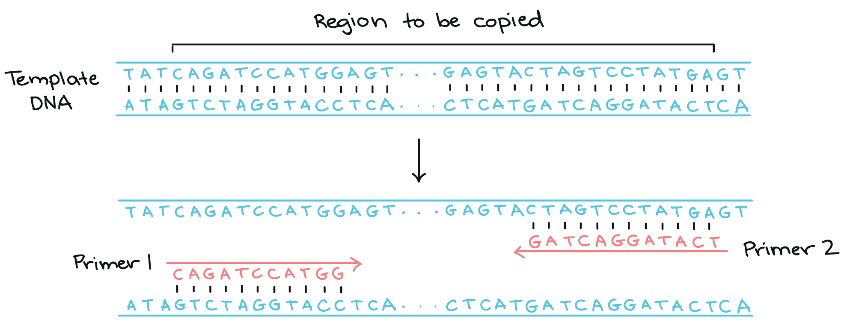
Practicum
Part A: Write a script to design primers to sequence the TP53 gene (given as fasta file). Keep in mind that primers typically have:
Length of 18-24 bases
40-60% G/C content
Start and end with 1-2 G/C pairs
Notes:
Melting temperature (Tm) of 50-60°C
Primer pairs should have a Tm within 5°C of each other
Primer pairs should not have complementary regions

Slide 112
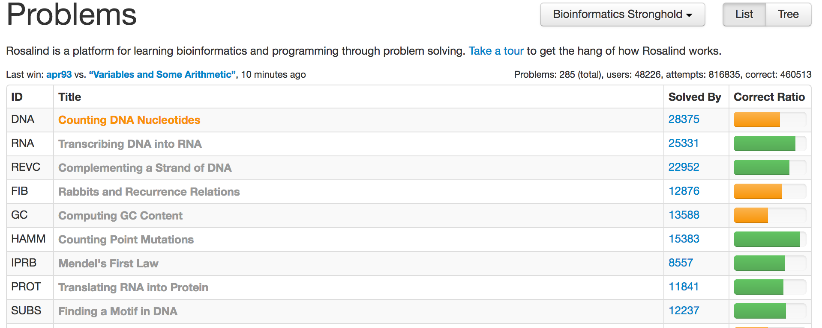
Rosalind Example
http://rosalind.info/problems/list-view/

Slide 113
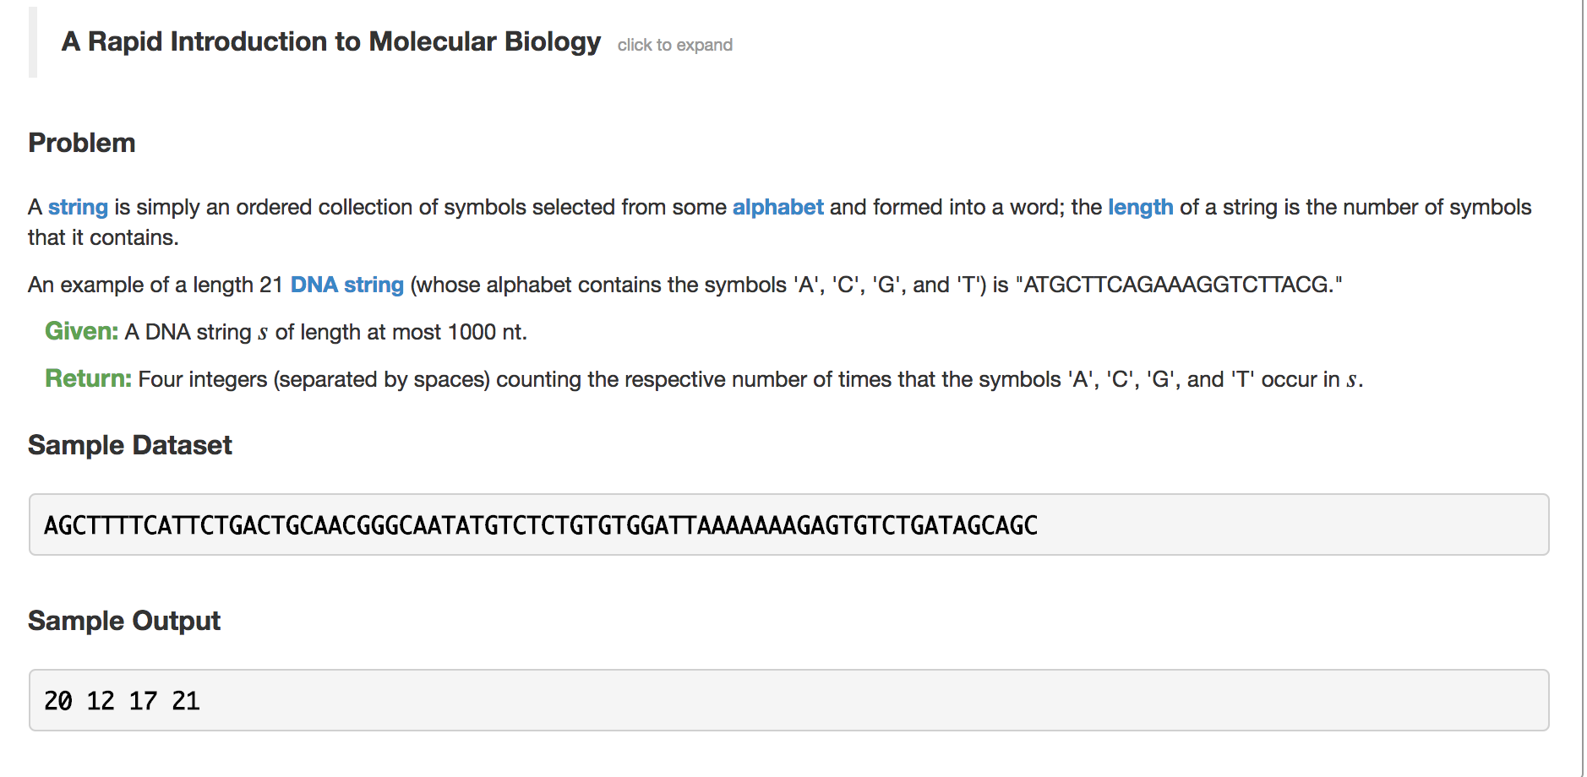
Problem 1

Slide 114
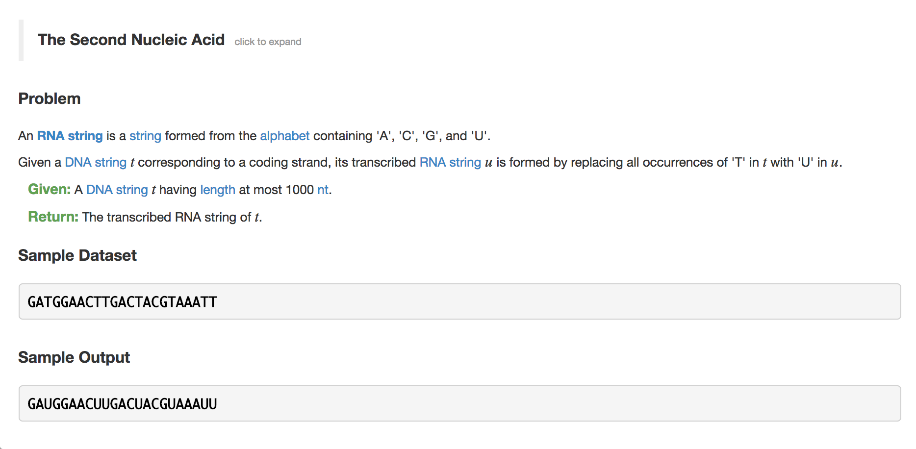
Problem 2

Slide 115
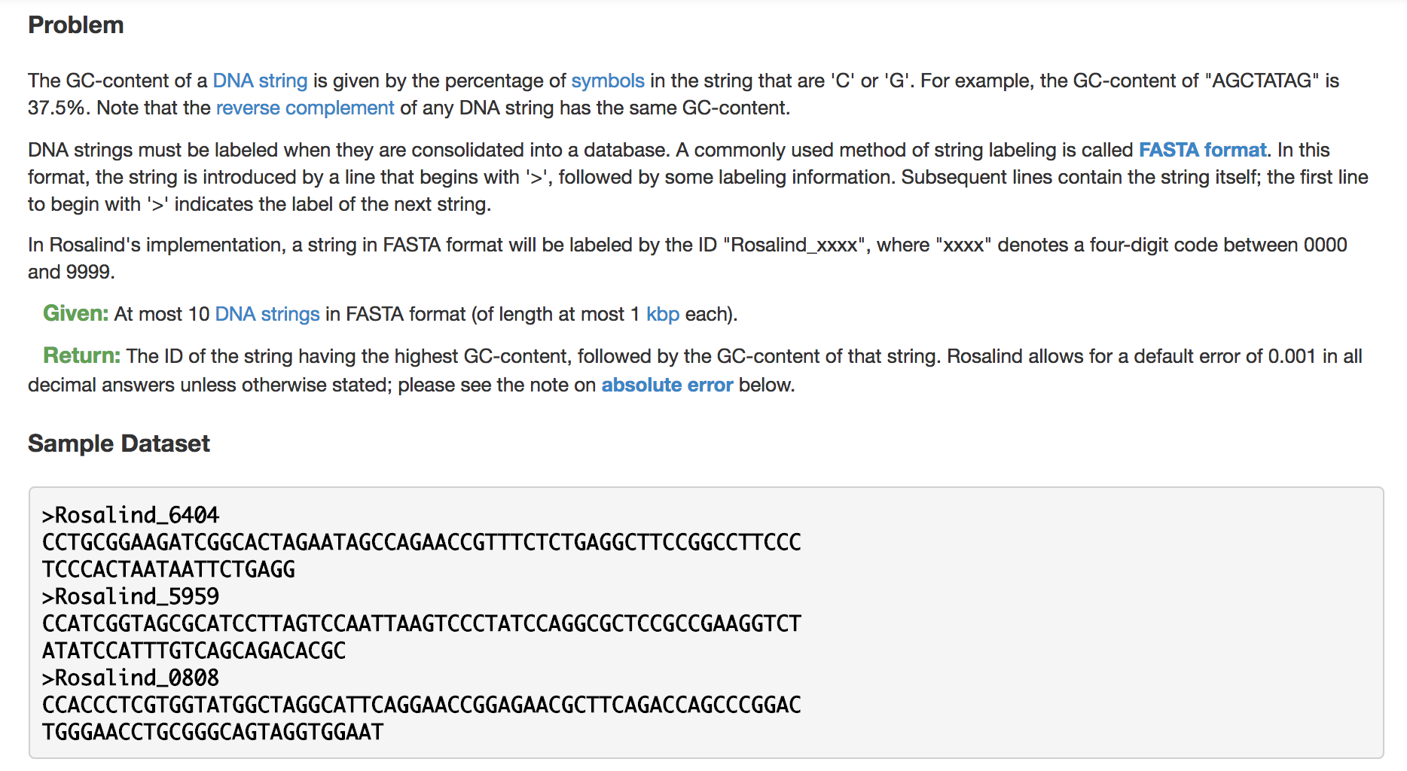
Problem 3

